Slide 1
Logic Shift and Rotate Instructions
Abdul Haseeb

Slide 2
Logic Operations
Change the Individual bits of the Data
AND, OR, XOR, NOT

Slide 3
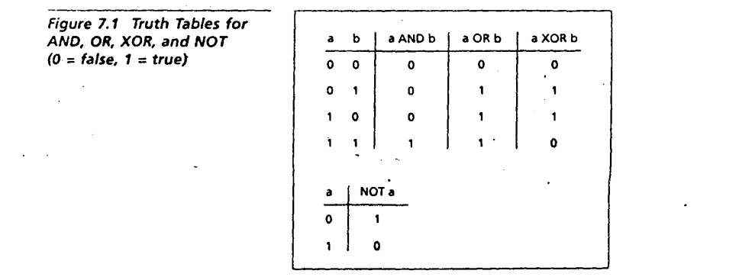
Truth Tables

Slide 4
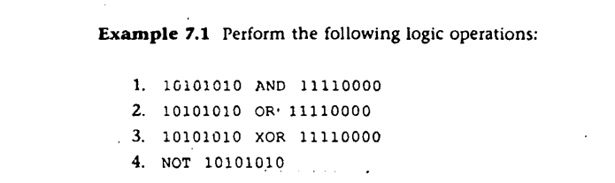
Task

Slide 5
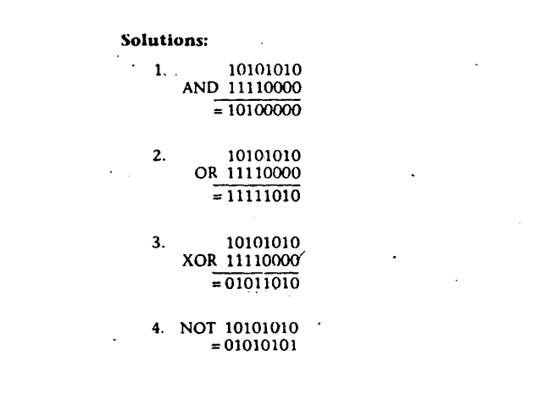
Solution

Slide 6

AND, OR, XOR Instructions

Slide 7
Masks
AND,OR,XOR instructions can be used with certain masks to perform some useful tasks

Slide 8
1. Converting ASCII Digit to a Number
AL gets ASCII code, when character input is taken
SUB AL,30h is one of the methods
AND AL,0FH
0FH is our mask to convert from ASCII code, to alphanumeric value

Slide 9
Task
Take two numbers as Input from user(numbers must be such numbers, that their sum doesn’t exceed 9)
Display the sum of their Addition
Note: you will use AND Masks

Slide 10
2. Converting Lowercase to Uppercase Letters
SUB DL,20h
AND DL,0DFH
ODFH is our mask

Slide 11
Assignment
Find out mask for Uppercase to Lowercase

Slide 12
Task
Take the name of your city as input, using function number 1, All letters should be lowercase
Display it over console, in UpperCase
Note: You will use AND Masks

Slide 13
Clearing a Register
One Way:
MOV AX,0
Other Way:
SUB AX,AX
New Way:
XOR AX,AX

Slide 14
Testing a Register for Zero
CMP CX,0
Alternative:
OR CX,CX

Slide 15
NOT
Performs one’s complement:
NOT AX

Slide 16
Try clearing, testing for zero and NOT

Slide 17
Test
TEST Instruction performs AND, but doesn’t change destination contents
Used for checking individual bits
We determine such a mask that the bits which we want to check, we set 1 in the mask for those bits

Slide 18
Example
We have the message:
0011011
We want to test the bits 2 and 3 so the mask would be:
0000110

Slide 19

Check for Even Numbers
Even Numbers have zero in bit 0, so the mask will be:
00000001=1

Slide 20
Shift Instruction
Shift the bits by one or more places
Shifted bits are lost

Slide 21
LEFT SHIFT
Perform Left Shifting Two places to the left
0 | 0 | 1 | 1 | 1 | 0 | 0 | 0
0 | 1 | 1 | 1 | 0 | 0 | 0 | 0
 | 1 | 1 | 1 | 0 | 0 | 0 | 0
 | 0 | 1 | 1 | 1 | 0 | 0 | 0
0 | 1 | 1 | 1 | 0 | 0 | 0
1 | 1 | 1 | 0 | 0 | 0 | 0
0 | 1 | 1 | 1 | 0 | 0 | 0 | 0
1 | 1 | 1 | 0 | 0 | 0 | 0 | 0
First Left Shift Done
Second Left Shift Done
Denary After Second Right Shift will be:
56*2²⁼224
Denary of Original Number is: 56
What should be the denary after first left shift?

Slide 22
Tasks
Convert 45 to 8 bit Binary Number and perform left shit three places to the left, show the binary
Convert 38 to 8 bit binary Number and perform left shit two places to the left

Slide 23

SHL Instruction
Performs left shift
CL Contains the count
The last bit which is shifted out is stored in CF Flag

Slide 24
RIGHT SHIFT
Perform RIGHT Shifting Two places to the RIGHT
0 | 0 | 1 | 1 | 1 | 0 | 0 | 0
0 | 0 | 0 | 1 | 1 | 1 | 0 | 0
0 | 0 | 0 | 1 | 1 | 1 | 0
0 | 0 | 1 | 1 | 1 | 0 | 0
 | 0 | 0 | 1 | 1 | 1 | 0 | 0
 | 0 | 0 | 0 | 1 | 1 | 1 | 0
0 | 0 | 0 | 1 | 1 | 1 | 0 | 0
0 | 0 | 0 | 0 | 1 | 1 | 1 | 0
First Right Shift Done
Second Left Shift Done
Denary After Second Right Shift will be:
56/2²⁼14
Denary of Original Number is: 56
What should be the denary after first Right shift?

Slide 25
Task
Convert 100 to binary and perform right shift two places to the right
Convert 240 to binary and perform right shift three places to the right

Slide 26
SHR Instruction
Performs left shift
CL Contains the count
The last bit which is shifted out is stored in CF Flag

Slide 27
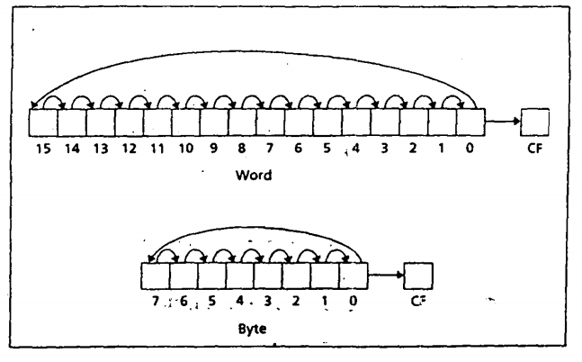
Rotate Instructions
ROR (Rotate Right):

Slide 28
Demo
1 | 0 | 1 | 0 | 1 | 1 | 0 | 1
1
 | 1 | 0 | 1 | 0 | 1 | 1 | 0
1 | 1 | 0 | 1 | 0 | 1 | 1 | 0

Slide 29
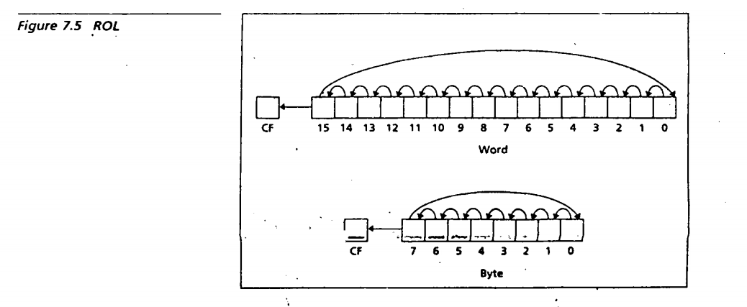
Rotate Instructions
Rotate Left:
MSB is shifted to rightmost bit
Opposite of RCL

Slide 30
Syntax
ROL destination,1 or ROL destination,CL
ROR destination,1 or ROR destination,CL

Slide 31
RCL (Rotate Carry Left)
Similar to ROL
Except the MSB gets copied into CF, and the value of CF is copied to rightmost bit

Slide 32
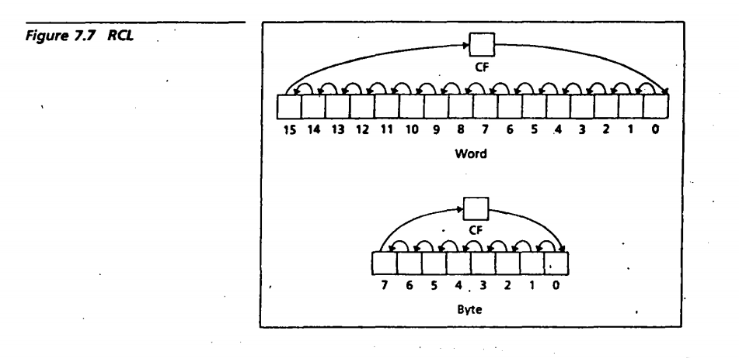
RCL

Slide 33
RCR (Rotate Carry Right)
Similar to ROL
Except the rightmost bit gets copied into CF, and the value of CF is copied to MSB

Slide 34
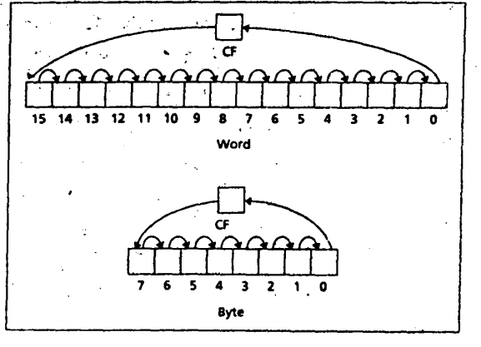
RCR (Rotate Carry Right)

Slide 35
Solving a problem using ROL
When we perform ROL CF also gets the value shifted out of MSB
JNC: Jump if no carry, causes a jump when value of CF=0

Slide 36
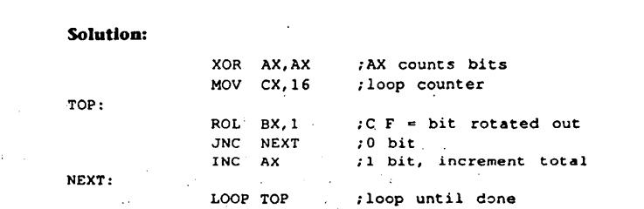
Count number of ones

Slide 37
Assignment
Input a 16 bit binary number
Display it on console

